Slide 1
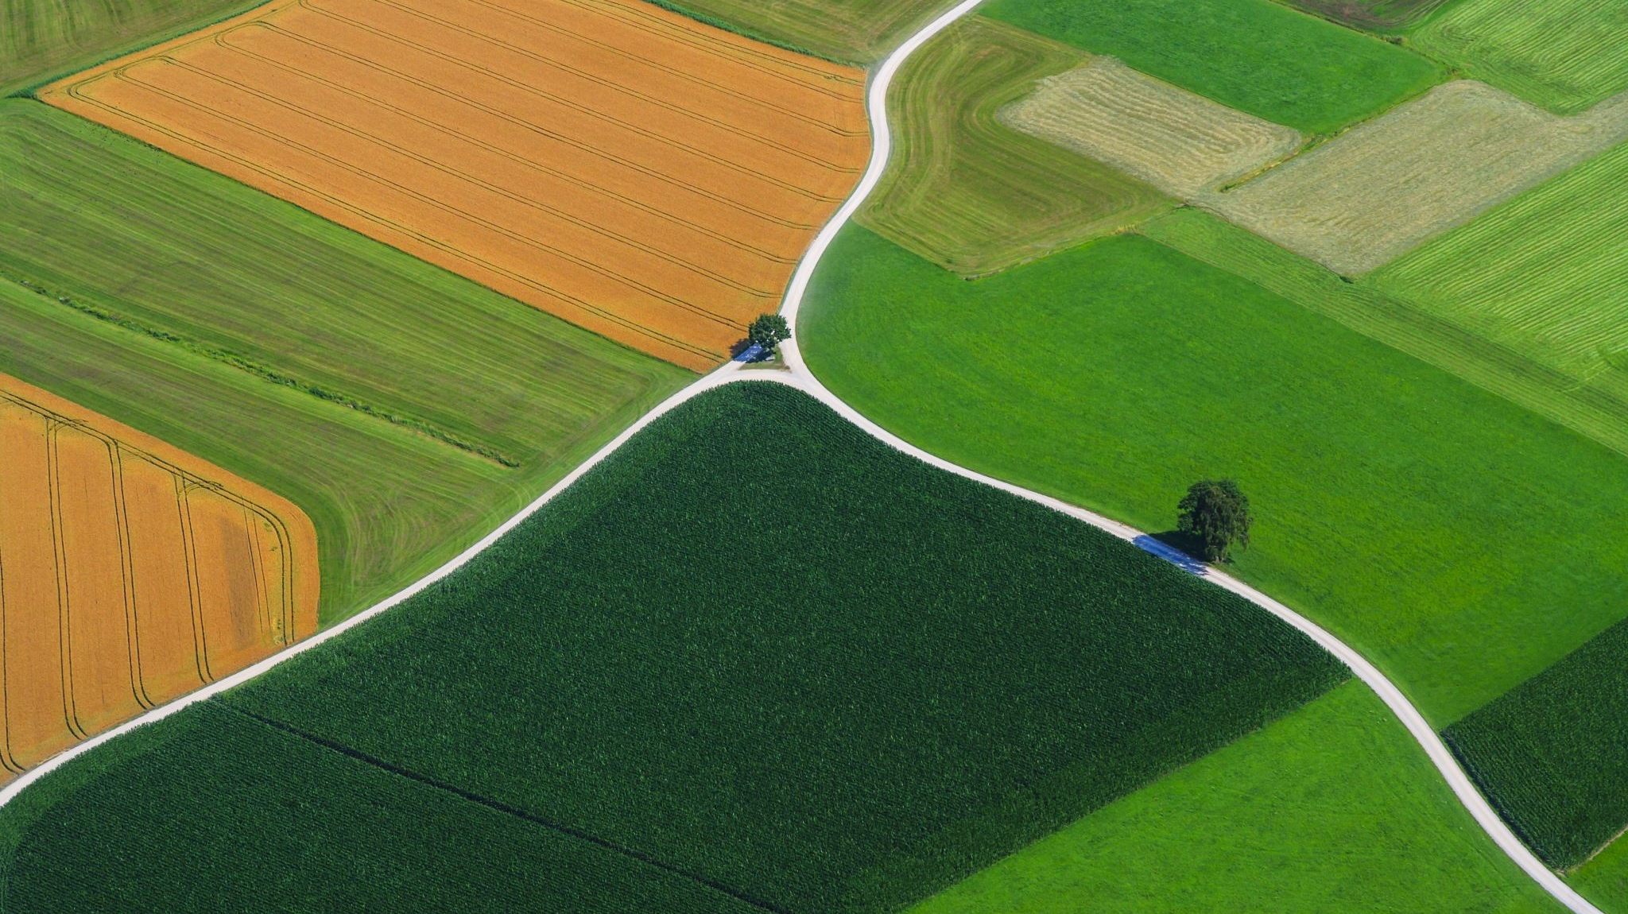
How to Follow Jesus
Become Christ-Like

Slide 2
Review
To Know God = Obey God’s Laws & His Will
(A) All kinds of “Christians” Around
(B) Are you a true disciple / follower of Christ?

Slide 3
True and False Disciple
Matthew 7:21-23 New International Version - UK (NIVUK)
True and false disciples
²¹ ‘Not everyone who says to me, “Lord, Lord,” will enter the kingdom of heaven, but only the one who does the will of my Father who is in heaven.
²² Many will say to me on that day, “Lord, Lord, did we not prophesy in your name and in your name drive out demons and in your name perform many miracles?”
²³ Then I will tell them plainly, “I never knew you. Away from me, you evildoers!”

Slide 4
Knowing God
God equates knowing Him to be the same as :
Obeying his laws
Doing His will
Our lives belongs to God
Submit to His ways and teachings
X Going to church or doing Christian stuff does not mean that we know Jesus.

Slide 5
Sin Nature and Law
Galatians 5:19-21 New Living Translation (NLT)
¹⁹ When you follow the desires of your sinful nature, the results are very clear: sexual immorality, impurity, lustful pleasures,
²⁰ idolatry, sorcery, hostility, quarreling, jealousy, outbursts of anger, selfish ambition, dissension, division,
²¹ envy, drunkenness, wild parties, and other sins like these. Let me tell you again, as I have before, that anyone living that sort of life will not inherit the Kingdom of God.

Slide 6

Needs For Law to Stop Sin Nature
1 John 3:4 New International Version - UK (NIVUK)
⁴ Everyone who sins breaks the law; in fact, sin is lawlessness.

Slide 7
Imagine a Lawless Road
No Traffic Light
No Road Signs
Likely to have road accidents, death and chaos

Slide 8
Imagine a Lawless Hospital
Anyone can be a doctor or nurse
You can walk into any room
No Queue System
Likely to endangered lives, death, lack of security, & great fear

Slide 9
Imagine a Lawless School
No time-table
No teachers
No test or exams
Likely to have great chaos, poorly disciplined students, inability to learn

Slide 10
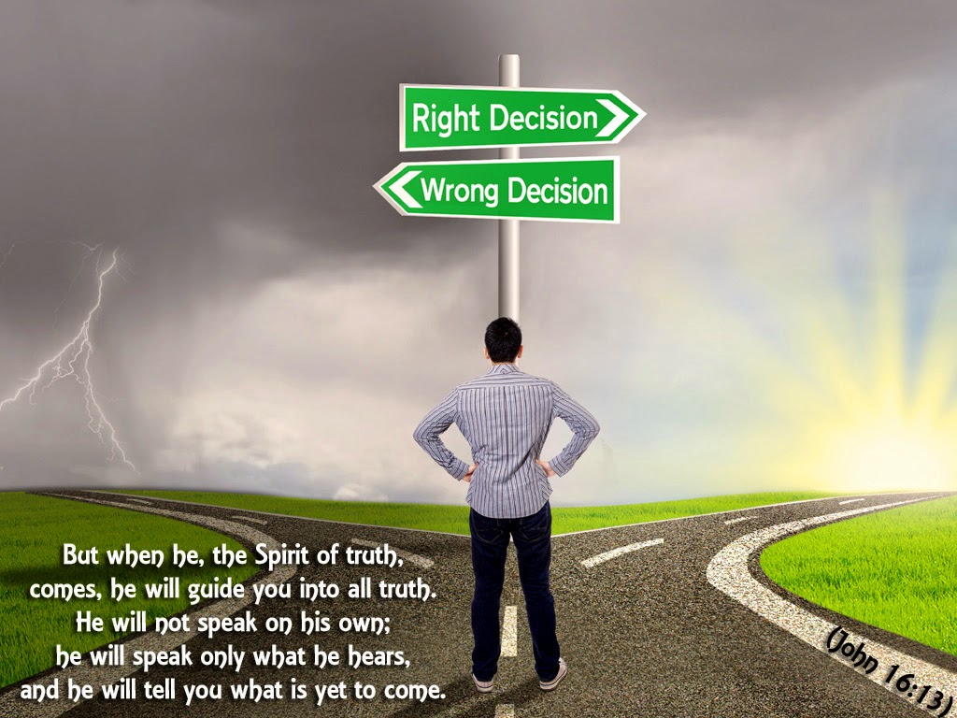
John
16:13

Slide 11
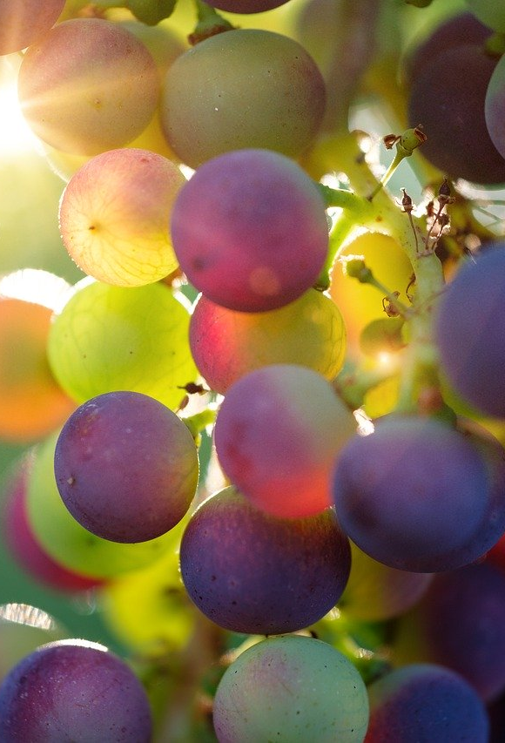
Fruit of the Spiirit
Galatians 5:16
¹⁶ So I say, live by the Spirit, and you will not gratify the desires of the flesh.
Galatians 5:22-23
²² But the fruit of the Spirit is love, joy, peace, forbearance, kindness, goodness, faithfulness, ²³ gentleness and self-control. Against such things there is no law.

Slide 12
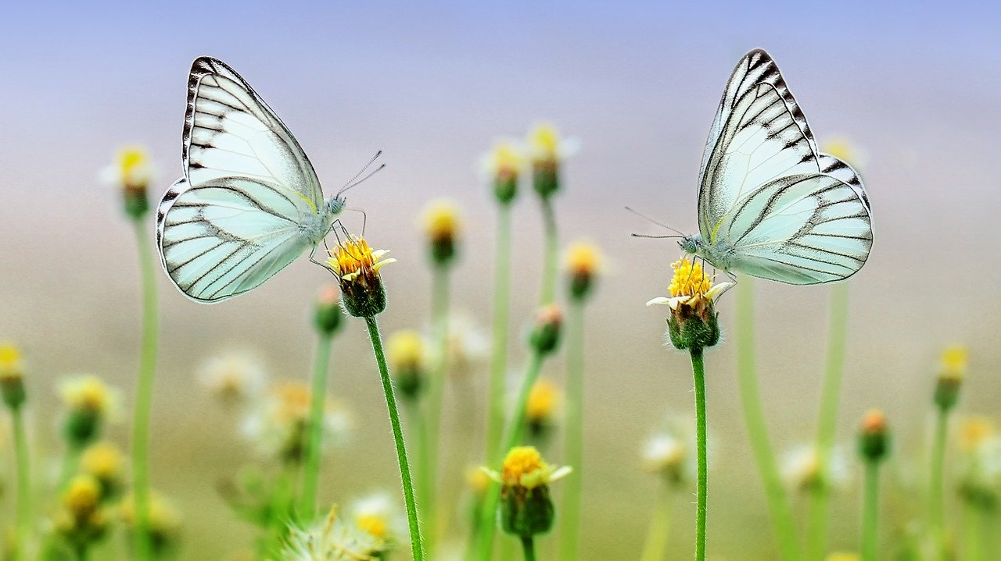
A new life has begun
2 Corinthians 5:17 New International Version - UK (NIVUK)
¹⁷ Therefore, if anyone is in Christ, the new creation has come: the old has gone, the new is here!

Slide 13

God’s handiwork
Ephesians 2:10
For we are God’s handiwork, created in Christ Jesus to do good works, which God prepared in advance for us to do.

Slide 14
The decisions we made daily

Slide 15
You can choose
You can be ashamed and fall away from Jesus..
because of peer pressure,
parents objecting to your decisions to believe in Jesus
Or you can choose to stand firm in your faith

Slide 16
You can choose
You can be busy and stop reading the bible
Or you can make it a priority to read God’s word

Slide 17
You can choose
You can doubt and blame God when things don’t go your way
Or you can choose to give thanks in all circumstances

Slide 18
Important Growth Area as Christians
Do your devotions daily
01
Attend a cell group / church service weekly
02
Attend equipping camps / classes
03

Slide 19

Jesus Loves You
Your life is precious and special.
You are loved by your heavenly Father
Saved from the sin nature by the saviour
Walk daily with Him
You can really be a blessings to your family members and friends

